Slide 1
Programming Parallella The Dot Product
Shashi Bhushan

Slide 2
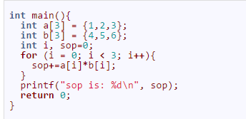
introduction
The dot product of two arrays is the sum of products
To understand, let us consider two arrays A=[1,2,3] and B=[4,5,6]
The dot product of these two arrays is 1x4 + 2x5 + 3x6 = 4+10+18 = 32

Slide 3
How does the parallelization works?
Let us see how to parallelize the dot product of two arrays of n elements ovet c cores
Assign n/c elements of each array to each core.
Each core will then calculate a local sum of products using the the n/c elements assigned to it, and send it to the host.
the host will sum all the local sums together to yield a final sum of products.

Slide 4
DOT Product process : An example
Suppose two arrays A = [4, 1, 3, 6] and B = [7, 5, 8, 2] and we need the dot product over two cores (c=2)
To parallelize this program on Epiphany, we do the following on the host:
The host initializes the device, and creates workgroup containing two cores.
The host assigns the first two elements of A and B to core 1. Thus, the arrays [4,1] and [7,5] exist on core 1’s local memory.
The host assigns the last two elements of A and B to core 2. Thus, the arrays [3,6] and [8,2] exist on core 2’s local memory.
The host executes the device program on each core
When the device program finishes executing, the host goes through each core and gets the local sums, and adds them together. This final sum is outputted to the user.

Slide 5
DOT Product process : An example Cont.
The following operations are performed by device side on each core:
Each core steps through the portion of A and B assigned to it, and computes the sum of the products. So, core 1 computes 4x7 + 1x5 = 28+5 = 33. Core 2 computes 3x8 + 6x2 = 24+12 = 36.
Once each core finishes computing the section of the original arrays assigned to it, it returns its local sum, and exits.

Slide 6
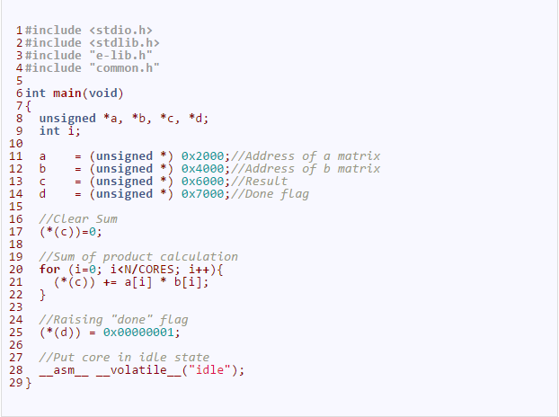
Dot product : Device program
As discussed before, there are always two programs, a host program and a device program
Lets first discuss the device program (e_task.c)

Slide 7
Dot product : Device program Cont.
Note inclusion of e_lib.h header file which provides various functions for epiphany
Here we have also included common.h which contains the definitions of N and CORES
Remember, each e-core has 4 8KB memory banks, located at addresses 0x0000, 0x2000, 0x4000 and 0x6000

Slide 8
Dot product : Device program Cont.
We have defined four unsigned integers pointers. The first three are set to three separate memory banks of epiphany core
The fourth pointer lies in the range of fourth memory bank
Only a and b are arrays, but not c. It is an static value which stores the result as seen in for loop
Once the sum is calculated, we set the done flag d to 0x1. The host program sees it and senses that it can now sum all the values and generate the output

Slide 9


Dot product : Device program
The sum of product of two vectors with elements between 0….N-1 is
In this example, we have assumed that N=64. with the above equation, we can calculate the sum of products to be 85334
The N value and the number of cores to be used are updated in common.h file

Slide 10
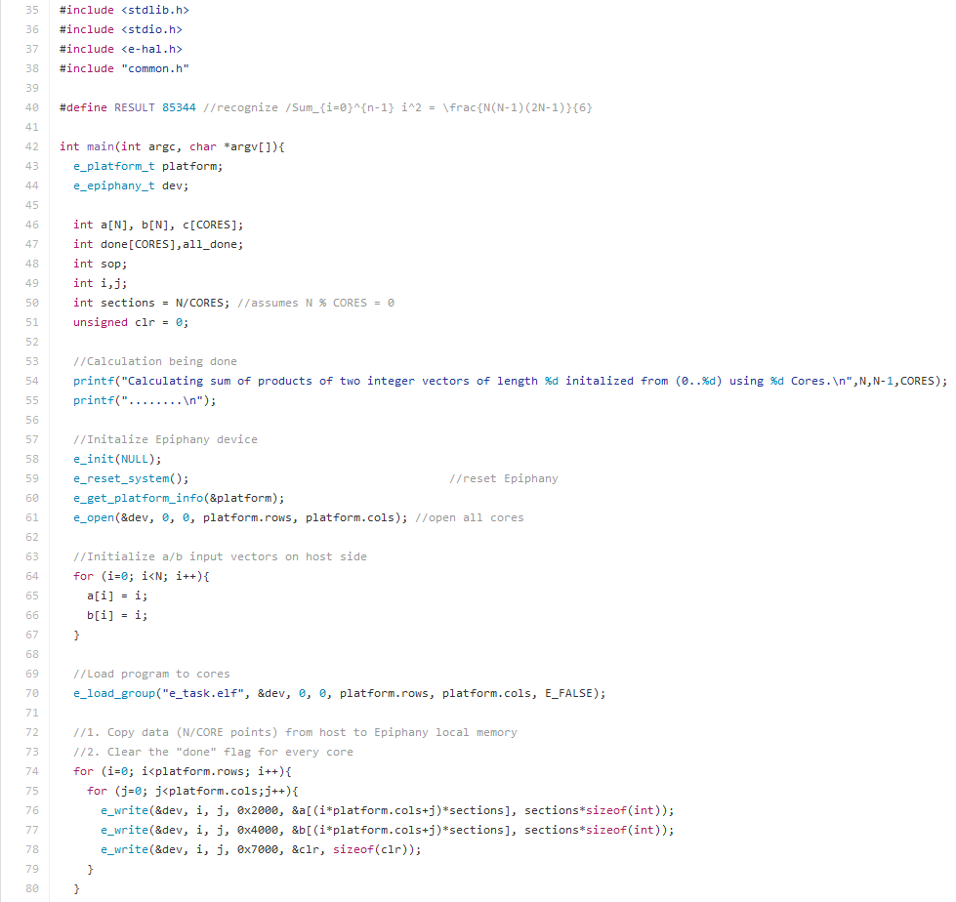
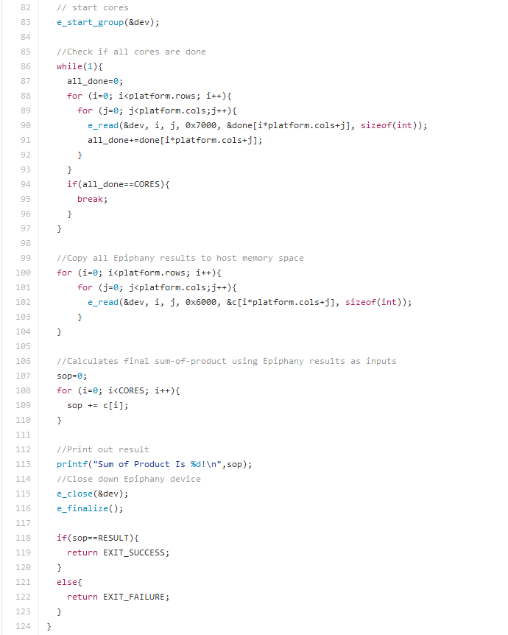
Dot product : Device program cont.

Slide 11
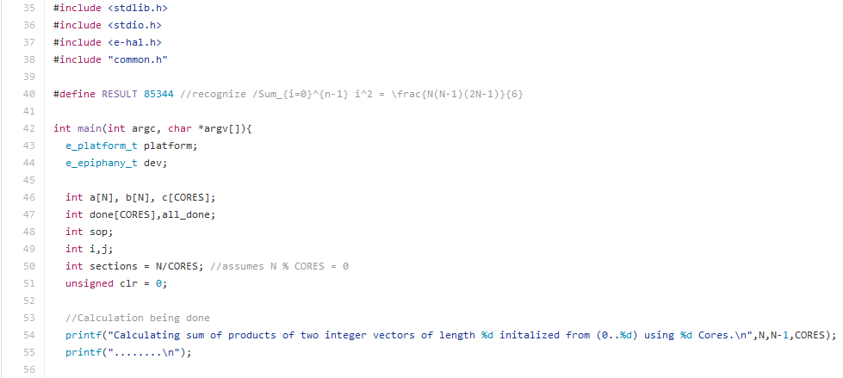
Dot product : Device program cont.
Note the use of int types for our variable definitions
The variable sections represents the size of chunk written to every core immediately before local sop calculation
We assign clr=0 and add printf to reflect the operation being performed

Slide 12
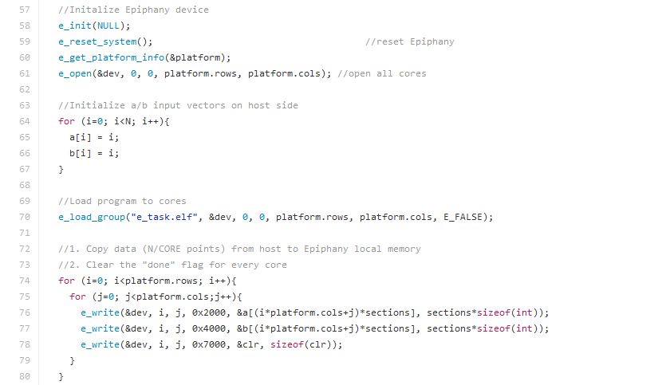
Dot product : Device program cont.
First we initialize the epiphany platform and establish the workgroup
Now we initialize arrays a and b
Now we write chunks to array a and b to the respective memory banks of each core using e_write
&a[(i*platform.cols+j) goes from 0 to number of cores
The sections weighs the counter depending on size of chunk to be written
The sections*sizeof(int) decides the number of bytes written to each memory bank

Slide 13
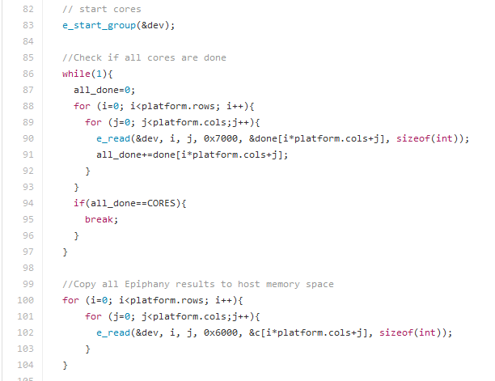
Dot product : Device program cont.
Now we start the cores to perform local computations
The while loop cycles through every core continuously
The value stored at location 0x7000 (local result) is read and stored in done array
This values is then added to variable all done
We wait till the results from all the cores are read and exit while loop afterit is done
Now we copy all epiphany results to the memory space of host

Slide 14
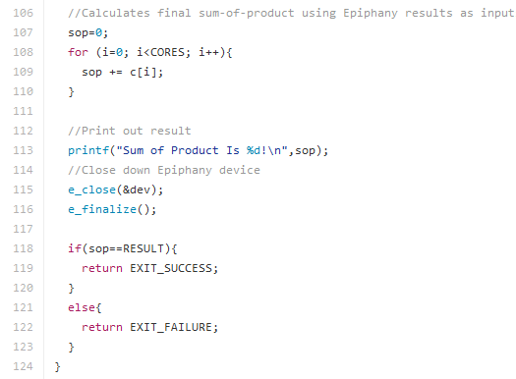
Dot product : Device program cont.
Here, first we calculate the final result using all local epiphany results and print the same
Finally, we close the epiphany and exit successfully if the final sum of product value is equal to the value defined above in RESULT variable

Slide 15
References
https://github.com/adapteva/epiphany-examples/tree/2016.3/apps/dotproduct
https://suzannejmatthews.github.io/2015/06/09/dot-product/
https://suzannejmatthews.github.io/2015/06/10/dot-product-revisited/

